Slide 1


AI-Driven OTC Medicine Vending Machines in Latvia
Artificial Intelligence Group Project
Group: 4403MDA
Sanita Šulca st89060
Vita Maurīte st89344
Mostafa Salem st91304
Toufic Jandah st88601
Joanns Engels st88578

Slide 2
Agenda
Artificial Intelligence Group Project
Smart OTC-VMs
Introduction
Research on the Topic Area
Project Management
Technical Implementation & Challenges
Results & Demonstration
Conclusions
References

Slide 3
Introduction
Artificial Intelligence Group Project
Smart OTC-VMs
Purpose of the project
Limited 24/7 pharmacy access in Latvia
Strong impact in rural regions
Real-life healthcare impact
Project goal
To improve accessibility and equity in healthcare, this project proposes an Artificial Intelligence (AI) based system for planning and managing OTC medicine vending machines (OTC-VMs)
Sanita Šulca – Product & Domain Lead

Slide 4
Objectives
Artificial Intelligence Group Project
Smart OTC-VMs
Improve access to OTC medicines
Optimize vending machine placement using data and AI
Forecast demand and support inventory planning
Design a safe and responsible user interaction system
Integrate legal, ethical, and regulatory considerations
Demonstrate a realistic research prototype
Apply data-driven project management practices
Sanita Šulca – Product & Domain Lead

Slide 5
Team Structure & Roles
Artificial Intelligence Group Project
Smart OTC-VMs
Product & Domain Lead - Sanita
Data Engineer - Vita
Data Scientist - Mostafa
App & Chatbot Developer - Toufic
Monitoring & Visualization Engineer - Joanns
Sanita Šulca – Product & Domain Lead

Slide 6






Project Management
Artificial Intelligence Group Project
Smart OTC-VMs
Responsibilities
Project idea & scope
Project coordination
Risk management
Legal & ethical framework
Testing oversight
SANITA
Contribution
Project proposal
Project charter, roles, kanban board, github
Risk register & DDS meeting minutes
Legal, ethical & compliance analysis
System testing & validation
PRODUCT &
DOMAIN LEAD
Transforms project requirements and constraints into coordinated team execution and validated outcomes
Sanita Šulca – Product & Domain Lead

Slide 7
Project Management Approach
Artificial Intelligence Group Project
Smart OTC-VMs
Data-Driven Scrum
Github + Kanban board
Regular meetings & integration reviews
Risk register (legal, data, delivery risks)
https://github.com/SanitaShu/AI-poject-TSI-Team-
Sanita Šulca – Product & Domain Lead

Slide 8
Domain & Regulatory Research
Artificial Intelligence Group Project
Smart OTC-VMs
Latvian OTC medicine regulations
Pharmacy operating hours & accessibility
GDPR and ethical constraints
WHO guidance on AI in healthcare
Sanita Šulca – Product & Domain Lead

Slide 9
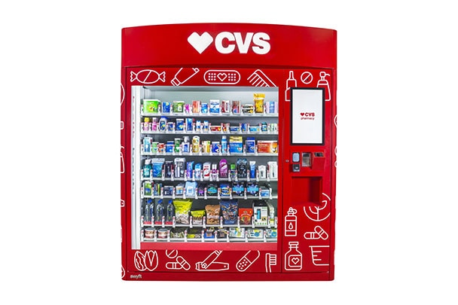
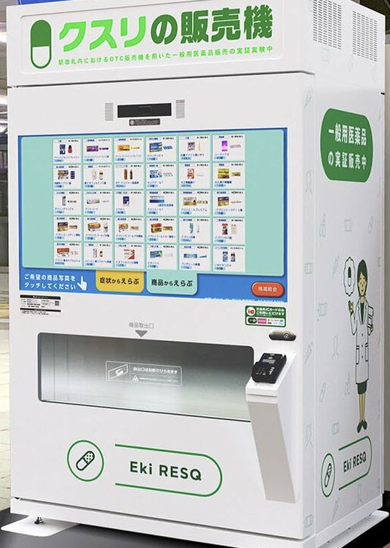
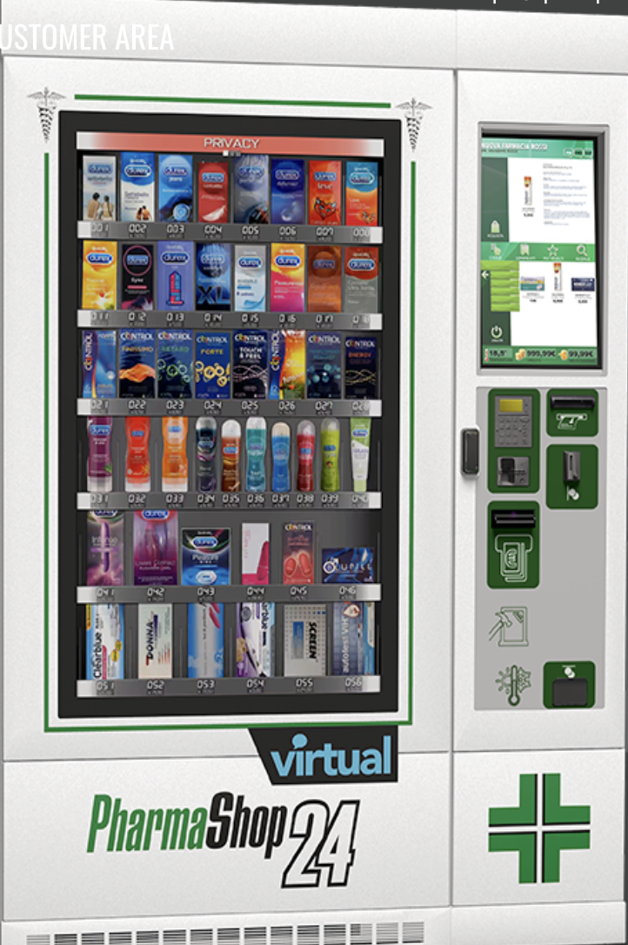
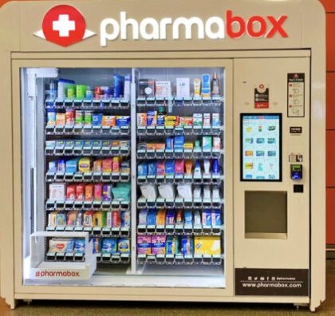
Case studies
Smart OTC-VMs
Artificial Intelligence Group Project
USA, Canada, Japan, China, India, UAE, EU countries
(emerging worldwide, pilots, trials, adoption varies widely by country due to different regulations and safety concerns)
Typical placement locations:
Airports, hospitals, shopping centers, stations, outside/near pharmacies
Identified best practices & limitations
Vita Maurīte – Data Engineer

Slide 10
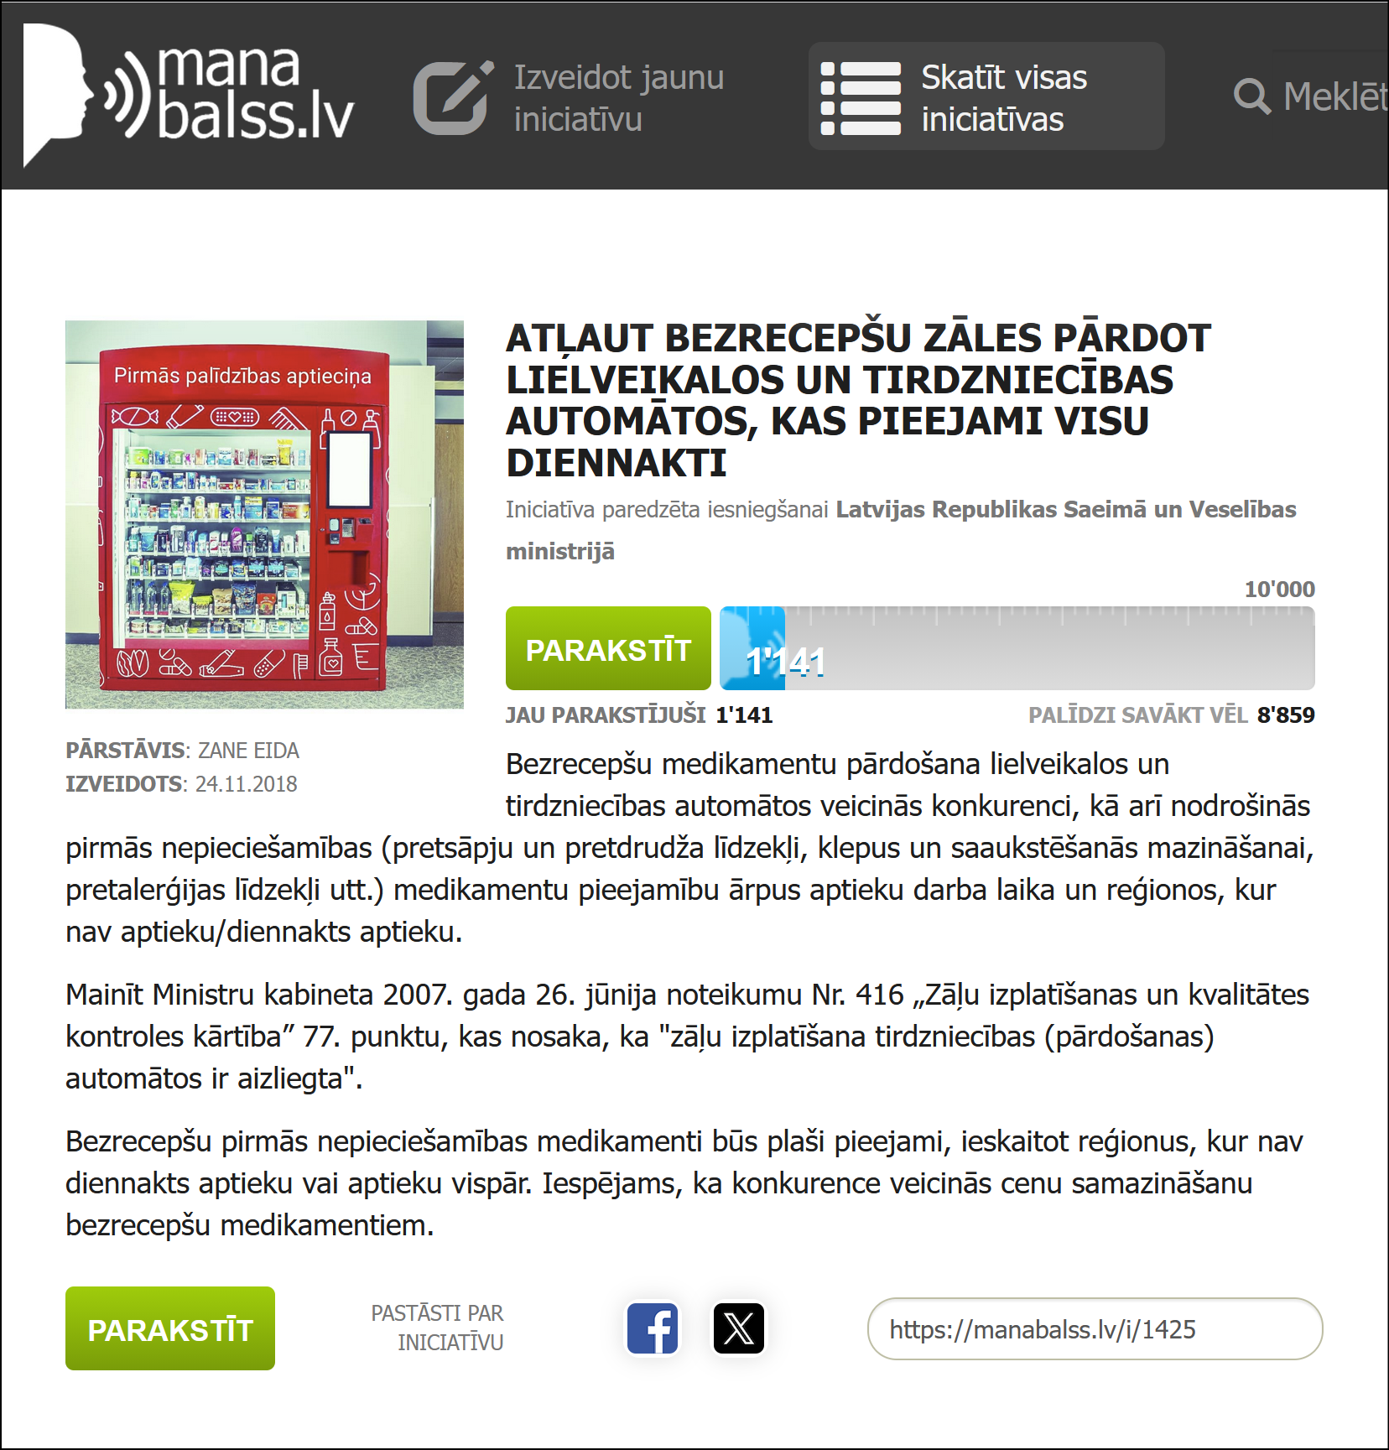
Legal & Ethical Constraints
Artificial Intelligence Group Project
Smart OTC-VMs
DGPR applies to facial recognition
AI must follow legal & ethical rules
OTC sales via VMs are not currently legal in Latvia
Advertising & misuse restrictions
https://manabalss.lv/atlaut-bezrecepsu-zales-pardot-lielveikalos-un-tirdzniecibas-automatos-kas-pieejami-24-st-dnn/show
Sanita Šulca – Product & Domain Lead

Slide 11
Research Outcomes
Artificial Intelligence Group Project
Smart OTC-VMs
Prototype only (no real sales)
OTC only (no prescription medicines)
Strict safety and purchase limits (1 product per category/24h)
Adult / child separation
Explicit consent & no long-term personal data storage
Explainable, non-diagnostic AI (with disclaimers)
Sanita Šulca – Product & Domain Lead

Slide 12
System Architecture Overview
Artificial Intelligence Group Project
Smart OTC-VMs
Data
Analytics
Application
Monitoring
Vita Maurīte– Data Engineer

Slide 13



Data Collection & Engineering
Artificial Intelligence Group Project
Smart OTC-VMs
Responsibilities
Data sourcing
Data cleaning
Standardization
OTC classification
Data delivery
VITA
Contribution
Collected official open datasets
Cleaned datasets
Unified data structure
User friendly OTC categories
Data for Scientist & App Developer
XML
csv
DATA ENGINEER
Transforms raw and fragmented data into clean, structured datasets for analytics and application development
Vita Maurīte - Data Engineer

Slide 14
Data Engineering challenges & solutions
Artificial Intelligence Group Project
Smart OTC-VMs
Challenges
Fragmented public datasets
Different formats
Complicated data
Solutions
Data cleaning & standardization
Unified data structure
Consumer-friendly OTC classification
Vita Maurīte - Data Engineer

Slide 15


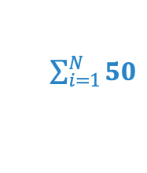
Analytics, Modeling & Allocation
Artificial Intelligence Group Project
Smart OTC-VMs
Responsibilities
Population analysis
Demand modeling
Allocation optimization
Coverage evaluation
Model validation
MOSTAFA
Contribution
Population trend + Growth rate
Demand score indicator for VMs placement
50 OTC-VMs allocation optimization
Coverage efficiency Model validation
Interactive dashboard updates
$\sum_{i=1}^{N}{50}$
DATA SCIENTIST
Transforms cleaned data into actionable data. Strategic decisions supported by data science
Mostafa Salem - Data Scientist

Slide 16
Data Science challenges & solutions
Artificial Intelligence Group Project
Smart OTC-VMs
Challenges
Limited geospatial granularity
No real transaction data
Uneven demographic patterns
Solutions
Municipality-level proxy points
Population-based demand modeling
Standardized demand score
Mostafa Salem - Data Scientist

Slide 17
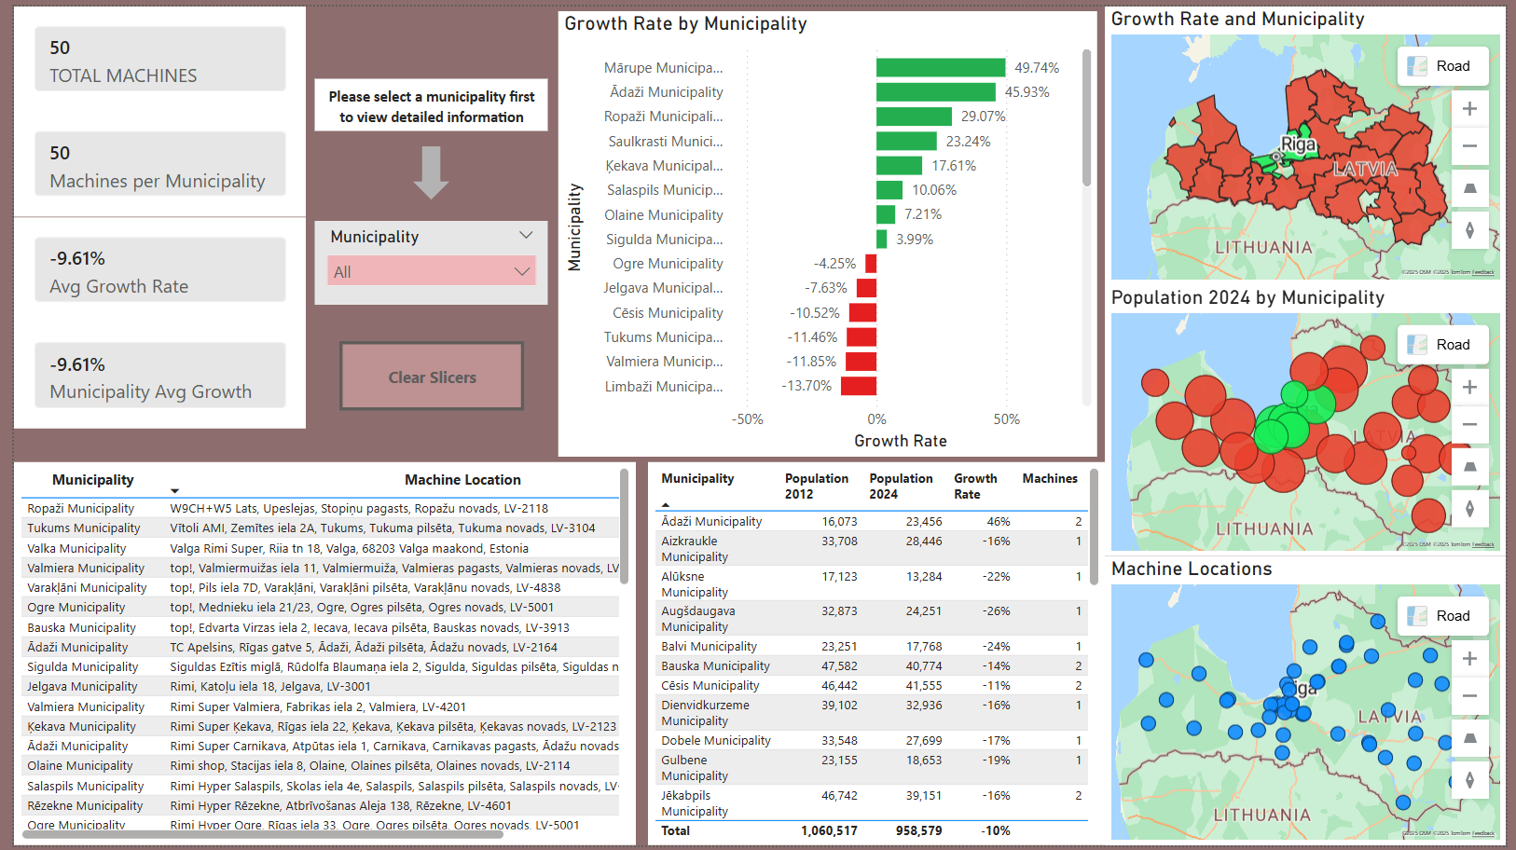
Interactive Dashboard
Artificial Intelligence Group Project
Smart OTC-VMs
Mostafa Salem - Data Scientist

Slide 18



App & Chatbot Developer
Artificial Intelligence Group Project
Smart OTC-VMs
Responsibilities
Full-stack development
System architecture & implementation
Frontend & backend development
AI & decision logic
Payment & security integration
Deployment & maintenance
TOUFIC
Contribution
End-to-end vending machine web app
Secure and scalable architecture
Responsive UI & backend logic
AI recommendations & safety logic
Facial recognition verification / PayPal
CI/CD deployment pipeline
UI
AI
APP & CHATBOT DEVELOPER
Transforms data and analytical outputs into a functional application
Toufic Jandah - App & Chatbot Developer

Slide 19
Application & Chatbot Development
Artificial Intelligence Group Project
Smart OTC-VMs
Challenges
PayPal SDK 400 errors
Poor lighting for CV
OpenAI API formatting
GitHub Pages deployment
Solutions
Fixed via retry + root-level provider
Implemented 5-attempt fallback
Resolved invalid value errors
Fixed base path + environment vars
Toufic Jandah - App & Chatbot Developer

Slide 20
Monitoring & Forecasting
Artificial Intelligence Group Project
Smart OTC-VMs
Responsibilities
Monitoring dashboards
Sales and profitability metrics
Demand forecasting
Visualized trends and KPIs
Demand prediction
JOANNS
Contribution
Demand forecasting
Profit & Revenue
Weekly forecast + Confidence interval
Stock monitoring
KPIs dashboard
KPIs
MONITORING FORECASTING
Transforms analytical results into monitoring dashboards and forecasting insights for decision support
Joanss Engels – Monitoring and Forecasting

Slide 21
Live Demo Links
Artificial Intelligence Group Project
Smart OTC-VMs
Smart Medicine Vending app
Machine Analysis Dashboard
Demand forecast dashboard
Toufic Jandah - App & Chatbot Developer

Slide 22
Key Results
Artificial Intelligence Group Project
Smart OTC-VMs
Optimized vending machine placement
Functional vending machine web app
Monitoring & forecasting dashboards
Legally and ethically compliant design
Mostafa Salem– Data Scientist

Slide 23
Conclusions & Recommendations
Artificial Intelligence Group Project
Smart OTC-VMs
AI can improve healthcare accessibility
Data quality is critical for optimization
Legal & ethical design is essential
Prototype suitable for pilot testing
Toufic Jandah - App & Chatbot Developer

Slide 24
Reflection & Future Work
Artificial Intelligence Group Project
Smart OTC-VMs
Reflection
Strong team collaboration
Importance of adaptability to data limitations
Future Work
OCR ID verification
Real transaction data integration
Geospatial demand modeling
Healthcare system integration
Real-world pilot deployment
Mostafa Salem - Data Scientist

Slide 25
References
Artificial Intelligence Group Project
Smart OTC-VMs
Manabalss ‘Reģistrē petīciju: “Pieejami bezrecepšu medikamenti automātos”’. Available at: https://manabalss.lv/i/3732
GitHub repository https://github.com/SanitaShu/AI-poject-TSI-Team-
Project charter https://github.com/SanitaShu/AI-poject-TSI-Team-/blob/main/ProjectCharter-.pdf
Kanban board https://github.com/users/SanitaShu/projects/2/views/2
User interface https://sanitashu.github.io/AI-poject-TSI-Team-/
Stock checks (admin panel; password – admin123) https://sanitashu.github.io/AIpoject-TSI-Team-/admin
Vending machine reposition (Power BI Dashboard) https://github.com/SanitaShu/AI- 4 poject-TSI-Team-/blob/main/Machine%20Analysis.pbix
Demand Forecast Dashboard (Live demo): https://demand-dashboard-19s4.onrender.com/
Meeting minutes https://github.com/SanitaShu/AI-poject-TSI-Team-/tree/main/Meeting%20minutes%20PDF
Legal, Etics and Compliance and legal path https://github.com/SanitaShu/AI-poject-TSI-Team-/blob/main/LEGAL_ETHICAL_AND_COMPLIANCE_ASSESSMENT_AND_LEGAL%20PATH.pdf
Rīga, Latvia

Slide 26
Thank you! Questions?
Artificial Intelligence Group Project
Smart OTC-VMs
Riga, Latvia

